Slide 1
Memory Hierarchy
We combine appendix B and chapter 2 to study the memory hierarchy
how it works
improvements to cache memory
improvements to virtual memory
we also briefly look at the ARM Cortex-A53 memory hierarchy
NOTE: we are omitting chunks of chapter 2 and appendix B

Slide 2
The “Memory” Problem
Significant improvements in processor speed
doubling every couple of years (until around 2005, but still increasing from 2005 through 2018)
DRAM access times increased mostly linearly since 1980
every year processor speed increases >> DRAM access time
since the processor accesses memory in every fetch-execute cycle, there is no sense increasing clock speed unless we find a faster form of memory
This is why we use
cache memory and
create the memory
hierarchy

Slide 3
Cache
Typical memory
hierarchy layout for
(a) mobile computers
(b) laptop/desktops
(c) servers

Slide 4
Performance Formulae
CPU execution time must factor in stalls from memory access
assume L1 cache responds within the amount of time allotted for the load/store/instruction fetch stage
e.g., 1 cycle
CPU time = IC * CPI * Clock cycle time
CPI = ideal CPI + stalls
stalls from both hazards and memory hierarchy delays (e.g., cache misses), or stalls = pipeline stalls + memory stalls
compute memory stall cycles (msc) as follows
msc = IC * (misses per instruction) * miss penalty
msc = IC * (memory accesses per instruction) * miss rate * miss penalty

Slide 5
Example
CPI = 1.0 when cache has 100% hit rate
data accesses are only performed in loads and stores
load/stores make up 50% of all instructions
miss penalty = 50 clock cycles
miss rate = 1%
How much faster is an ideal machine?
CPU time ideal = IC * 1.0 * clock cycle time
CPU time this machine = IC * (1.0 + 1.50 * .01 * 50) * clock cycle time = IC * 1.75 * clock cycle time
ideal machine is 1.75 times faster (75%)

Slide 6
Cache Questions
Where can a block be placed?
determined by type of cache (direct-mapped, set associative)
How is a block found?
requires tag checking
tags get larger as we move from direct-mapped to some level of associativity
amount of hardware required for parallel tag checks increases
causing the hardware to become more expensive and slower
Which block should be replaced on a miss?
direct-mapped: no choice
associative: replacement strategy (random, LRU, FIFO)
What happens on a write?
read B-6..B-12 if you need a refresher from CSC 362

Slide 7
Write Strategy Example
Computer has a fully associative write-back data cache
Refill line size is 64 bytes
x, b and c are double arrays of 1024 elements
assume b & c are already in cache and moving x into the cache does not conflict with b or c
x[0] is stored at the beginning of a block
Questions:
how many misses arise with respect to accessing x if the cache uses a no-write allocate policy?
how many misses arise with respect to accessing x if the cache uses a write allocate policy?
redo the question with S2 before statement S1
for(i=0;i<1024;i++) {
x[i] = b[i] * y; // S1
c[i] = x[i] + z; // S2
}

Slide 8
Solution
Refill line size = 64 bytes
each array element is 8 bytes, 8 elements per refill line
misses arise only when accessing x
No-write allocate policy means
a miss on a write sends the write to memory without loading the line into cache
a miss in S1 does not load the line and so S2 will also have a miss
a miss on a read causes line to be brought into cache
a miss in S2 causes line to be brought into cache
along with the next 7 array elements
read misses occur for the first array element and every 8th thereafter
1024 / 8 = 128 read misses
read miss in S2 will have had a write miss in S1, 256 total misses
Write allocate policy means write miss in S1 loads the line into cache (so no miss in S2)
therefore will have a total of 128 misses
Reversing the order of S1 and S2 leads to the read miss happening first, so 128 total misses no matter which policy is used

Slide 9
Write Buffer
To support write through, add a write buffer
buffer caches updated lines so that, to the CPU, writing to cache is the same as writing to memory
but writes to memory get temporarily cached
successive writes to the same block get stored in the buffer
only if writes are to different blocks will the current write buffer contents be sent to memory
on cache miss, check buffer to see if it is storing what we need
example: 4-word write buffer, and in the code below, 512 and 1024 map to the same cache line
sw x3, 512(x0) – write to buffer
lw x1, 1024(x0) – load causes block with 512 to be discarded
lw x2, 512(x0) – datum found in write buffer, small penalty!

Slide 10
Performance: Unified Versus Split Cache
Recall we want 2 caches to support 2 accesses per cycle: 1 instruction, 1 data
what if we had a single, unified cache?
assume either two 16KB caches or one 32KB cache
assume 36% loads/stores and a miss penalty of 100 cycles
use the table below which shows misses per 1000 instructions (not miss rate)
Size | Instruction cache | Data cache | Unified cache
8 KB | 8.16 | 44.0 | 63.0
16 KB | 3.82 | 40.9 | 51.0
32 KB | 1.36 | 38.4 | 43.3
64 KB | 0.61 | 36.9 | 39.4
128 KB | 0.30 | 35.3 | 36.2
256 KB | 0.02 | 32.6 | 32.9

Slide 11
Solution
Convert misses/instruction to miss rate
unified cache: 43.3 misses per 1000 instructions
miss rate 32KB unified = 43.3/1000/(1+.36) = .0318
split caches
miss rate 16KB instruction cache = 3.82/1000/1 = .004
miss rate 16KB data cache = 40.9/1000/.36 = .114
overall miss rate = (1/1.36) * .004 + (.36/1.36) * .114 = .0326
split cache EAT = 1 + .0326 * 100 = 4.26
unified cache EAT = 1 + .0318 * 100 + .0318 * .36 * 2 * 100 = 6.47
unified cache can only respond to 1 access at a time, so if we have a load/store, that load/store waits 1 cycle
split caches have poorer miss rates but performance is far better because unified cache requires stalling an instruction fetch when there is a need to access a datum

Slide 12
Miss Rates: the 3 C’s
Cache misses can be categorized as
compulsory misses
first access to a line – this results from a process just starting or resuming so that the first access is a miss
capacity misses
cache cannot contain all lines needed for the process – results from not having a large enough cache
conflict misses
mapping function causes new line to be inserted into a line that will need to be accessed in the near future
direct-mapped caches have no replacement strategy, so this argues for some amount of associativity in our caches
Some optimizations focus on one particular type of miss
conflict misses are more common in direct-mapped caches while fully associative caches never have conflict misses
capacity misses are the most common cause of a cache miss
see figure B.8 on page B-24

Slide 13
Impact of Associativity
One way to improve (lower) miss rate is to use associativity
use a replacement strategy to better support locality of reference and result in a lower conflict miss rates
associativity requires more hardware and thus slows the clock speed
is it worthwhile?
Base machine has CPI of 1.0
clock cycle time of .35 ns
128 KB direct mapped cache, 64 words per line, miss penalty of 65 ns
assume 1.4 memory references per instruction
should we replace the direct-mapped cache with a 2-way set associative cache if it increases clock cycle time by 35%?

Slide 14
Solution
Using figure B.8, we have the following miss rates
direct mapped cache = 2.1%, 2-way assoc cache = 1.9%
Miss penalty = 65 ns
EAT = hit time + misses/instruction * miss penalty
DM EAT: .35 ns + .021 * 65 ns = 1.72 ns
2-way EAT: (.35 * 1.35) ns + .019 * 65 ns = 1.71 ns
But clock rate is lengthened for our associative cache
CPU time = IC * (CPI + misses) * clock rate =
IC * (CPI * clock rate + miss rate * accesses per cycle * miss penalty)
DM: IC * 1.0 * .35 ns + (.021 * 1.4 * 65 ns) = IC * 2.26 ns
2-way: IC * 1.0 * .35 ns * 1.35 + (.019 * 1.4 * 65 ns) = IC * 2.20 ns
the 2-way offers a slight improvement
we’ll see a fuller example shortly

Slide 15
Impact on OOC
In our previous example, we saw that a cache miss resulted in a set number of stalls
this is the case in a pipeline
with out-of-order completion, a cache miss can be somewhat hidden
Our machine is the same as the previous example but with the 35% longer clock cycle (.35 ns * 1.35)
we will use the same direct mapped cache with a 65 ns miss penalty but assume 30% of misses is hidden because of reservation stations giving us a reduction in miss penalty from 65 ns to 45.5 ns
CPU time = IC * (1.6 * .35 * 1.35 + .021 * 1.4 * 45.5) = IC * 2.09
so, in spite of a slower clock, we see a significant improvement

Slide 16
Cache Optimization Strategies
In section 2.3 and B.3, we focus on 17 different strategies (one is not in the book)
recall: EAT = hit time + miss rate * miss penalty
Reduce EAT by reducing any of these three values
reducing hit time
hit time impacts every access so seems to be the most significant part of EAT to improve
but reducing hit time usually means a faster cache which technologically, is going to be hard to improve on other than using D-M caches
reducing miss rate – we may be reaching a limitation here
reducing miss penalty – this is the largest of the values
Two additional approaches improve cache performance through parallelism
reduce miss penalty and/or miss rate by parallelism
increase cache bandwidth

Slide 17
Larger Block Sizes
Larger block size brings more to cache at a time
this will reduce compulsory misses
Larger blocks mean fewer blocks
this may negatively impact conflict misses
Larger block sizes take more time to transfer
this will negatively impact miss penalty
Example: 4KB cache, 16 vs 32 byte blocks
assume memory access = 80 cycles + 2 cycles/16 bytes
EAT 16-byte blocks = 1 + .0857 * 82 = 8.027 cycles
EAT 32-byte blocks = 1 + .0724 * 84 = 7.082 cycles
see figure B.12, page B-28, for comparison of various block sizes on different cache sizes
32 byte blocks are best for 4K caches, 64 byte blocks best for larger caches

Slide 18
Higher Associativity
Research points to the “2:1 cache rule of thumb”
cache of size N has about the same miss rate as a cache of size N / 2 of the next higher associativity
e.g,. 32 KB D-M cache has similar miss rate (.042) as 16 KB 2-way cache (.041) – see figure B.8 on page B-24
there is no significant improvement over an 8-way set
no need for 16-way, 32-way, etc
Question: which type of cache should we use?
choose between direct-mapped, 2-, 4- or 8-way cache?
increased associativity requires slowing down clock speed
let’s test this out assuming
clock rates of 1.00 (DM), 1.36 (2W), 1.44 (4W), 1.52 (8W)
miss penalty of 25 clock cycles
caches of 4KB and 512 KB

Slide 19
Solution
4K cache (see figure B.8 for miss rates)
DM: 1.00 + .098 * 25 = 3.44 ns
2W: 1.36 + .076 * 25 = 3.26 ns
4W: 1.44 + .071 * 25 = 3.22 ns
8W: 1.52 + .071 * 25 = 3.3 ns
512K cache
DM: 1.00 + .008 * 25 = 1.2 ns
2W: 1.36 + .007 * 25 = 1.54 ns
4W: 1.44 + .006 * 25 = 1.59 ns
8W: 1.52 + .006 * 25 = 1.67 ns
see figure B.13 on page B-30 for a summary of results, notice that DM is the best for caches of 16K or larger, 4-way best for smaller caches
increased associativity has a greater impact on smaller caches
these results do not take into account how the increased clock speed impacts other parts of the processor
prefer associativity for L2 caches over L1 for this reason

Slide 20
Multi-Level Caches
Competing ideas for our L1 cache
larger caches improve miss rate but take up more space
higher associativity improves miss rate but slows clock speed
we want to maximize clock speed
we want to keep costs down
Solution: add a larger, higher associativity cache to the processor (or off-chip) that backs up L1 so that miss penalty is reduced but hit time is not impacted
we can have L2 and L3 caches if it is economically feasible
Today, the L2 is on the chip and shared between cores
one problem is that L2 cannot respond to two or more cache requests at the same time
so hit time for L2 can vary based on the number of requests
aside from cost, there may not be room for an L3 cache on some devices like a smart phone

Slide 21
EAT for Multi-level Cache
Our EAT formula goes from
Hit time + miss rate * miss penalty to
Hit time1 + miss rate 1 * (hit time 2 + miss rate 2 * miss penalty 2) to
Hit time1 + miss rate 1 * (hit time 2 + miss rate 2 * (hit time 3 + miss rate 3 * miss penalty))
L2 duplicates everything in L1
so even though L2 is much larger, its miss rate does not necessarily reflect the difference in size completely
We divide the L2 (and L3) miss rate into
local miss rate – number of accesses at L2 that are misses / number of L2 cache accesses
global miss rate – number of misses at L2 / number of total cache accesses = L1 miss rate * L2 local miss rate

Slide 22
Example
D-M L1 cache
hit time = 1 clock cycle, miss rate = 3.94%
L2 is 128 KB 2-way set associative cache
hit time of 5 clock cycles
local miss rate of 40%
global miss rate = 3.94% * 40% = 1.6%
L3 is off-chip 1 MB 8-way set associative cache
hit time = 10 clock cycles, local miss rate of 25%
global miss rate = 1.6% * 25% = .004
Memory access time = 80 clock cycles
What is the performance with all three caches? without the 2nd on-chip cache? without L3?
EAT 3 caches = 1 + .0394 * (5 + .40 * (10 + .25 * 80)) = 1.67
EAT without L2 = 1 + .0394 * (10 + .25 * 80) = 2.18
EAT without L3 = 1 + .0394 * (5 + .40 * 80) = 2.46

Slide 23
Priority to Read over Write Misses
Reads (loads) occur with a much greater frequency than writes (stores) – make the common case fast
writes are slower because the tag check must occur prior to starting the write, write may also need to go memory
tag check for reads can be done in parallel with the read
the read is canceled if the tag is incorrect
Use a write buffer for both types of write policy
write-through cache writes to write buffer first
read misses given priority over writing the write buffer to memory
write-back cache writes to write buffer and the write buffer is only written to memory when we are assured of no conflict with a read miss
in either case, a read miss will first examine the write buffer before going on to memory in order to potentially save time

Slide 24
Avoiding Address Translation
The CPU generates a logical address into virtual memory
this must be mapped to a physical address before memory can be accessed
even if the mapping information is found in the TLB, it requires 2 cache accesses
TLB miss requires page table access in DRAM
Solution: cache instructions and data in the L1 cache using their virtual addresses instead of the physical address
this has its own problems and solutions
read the text for a complete analysis (pages B-36 – B-40)
we return to this later in these notes

Slide 25
Small/Simple L1 Caches
Simple means direct-mapped
reduces hit time so that our system clock can be faster
direct-mapped caches also have shorter tags
direct-mapped caches require lower power consumption because only one line is examined (rather than 2 in a 2-way or 4 in a 4-way, etc)
with a direct-mapped cache, we can overlap tag check and data access into two cycles
this allows us to create a super-pipelined computer where the clock cycle is halved (as we saw with the MIPS R4000)
the deeper pipeline gives us greater speedup both because of the clock cycle improvement and having a greater amount of instructions in the pipe at a time
the cost of the simple cache is a higher miss rate

Slide 26
Way Prediction
Use a 2-way set-associative cache to act like a direct-mapped cache as follows
given address, predict which set to examine, 0 or 1
perform tag comparison based on prediction
on a hit, we’re done, 0 cycle stalls
on a miss, check the other set, 1 cycle stall
update prediction for next time within the same cycle
on a miss of the second set, it’s a true cache miss, go to the next level of the memory hierarchy
The 2-way set associative cache’s miss rate doesn’t change
hit time on first access = hit time of direct-mapped cache
because we didn’t employ extra hardware for parallel tag checking
on a miss to the predicted set but hit to other set, hit time is 2 * direct-mapped cache hit time (2 cycles)
prediction accuracy for a 2-way set associative cache can be as high as 90%

Slide 27
Variation: Pseudo-Associative Cache
Use a direct-mapped cache but simulate a 2-way set associative cache as follows
given address, do tag comparison at given refill line
on hit, no change
on miss, invert last two (or first two) bits of the line number, check that tag – on a hit, 1 cycle penalty (second access takes an extra cycle)
on miss, go to the next level of the hierarchy
Now we can employ a replacement strategy
given a refill line, place it in its proper location or in the location with the last two (or first two) bits of the line number reversed
Example:
address of line number: 1010111101
search (or place new item) at 1010111101 or 1010111110
DM cache has same miss rate as a 2-way set associative cache without the expense or slowing the clock

Slide 28
Examples
To employ a 2-way set associative cache we have to increase clock speed by 25%
hit time is 1 (DM), 1.25 (2-W)
miss penalty is 10 clock cycles
On-chip 8KB cache
D-M miss rate = .068, 2-way miss rate = .049
EAT D-M = 1 + .068 * 10 = 1.68
EAT 2-way = 1.25 + .049 * 10 = 1.74
EAT way prediction = .9 * 1 + .1 * 2 + .049 * 10 = 1.59
EAT pseudo-assoc = 1 + .019 * 1 + .049 * 10 = 1.509
pseudo-associative is best here although it is more expensive than way-prediction
with a 16KB cache, way prediction does worse than D-M!

Slide 29
Multi-Banked Caches
A common memory optimization is to have multiple memory banks
each bank can be accessed independently for parallel accesses
independent accesses to different banks (high order interleave)
or access to several consecutive locations (low order interleave)
Multiple cache “banks” can allow for interleaved cache accesses
multiple cache accesses during the same clock cycle to accommodate superscalar processors with multiple load/store units
low-order interleave shown here

Slide 30
Variation: Pipelined Cache Access
Recall MIPS R4000 was superpipelined
divide cache accesses into multiple pipe stages (cache accesses are now pipelined)
decreases clock cycle time
two stages: cache access, tag check
increases number of data dependency stalls as instructions will have to wait an additional cycle for datum to be forwarded
many architectures have adopted this approach
Sun Niagra, ARM Cortex A-8 and Intel Core i7: 4 L1 banks
AMD Opteron: 2 L2 banks, i7: 8 L2 banks (pipelining L2 has no impact on clock speed but is actually used for power saving
in general, instruction cache access is pipelined more often than data cache accesses
in part because of branch prediction accuracies and in part because instructions are never written too
data write tag checking has to be performed prior to physically writing the datum to the cache

Slide 31
Non-Blocking Caches
Ordinary cache misses result in the cache blocking
cache cannot respond to another request until the refill line from the next level has been brought into the cache
A non-blocking cache can continue to respond to CPU requests while waiting for earlier miss to be resolved
more expensive cache, lessens impact of stalls in out-of-order completion architectures
sometimes referred to as a “hit under miss” because part of the miss penalty is hidden as the processor continues to work
a second request must be to a different line than the one of the miss
often non-blocking caches start to block upon a second miss
experimental research shows miss penalties can be reduced by 20-30% with a “one hit under miss” non-blocking cache
A non-blocking cache does not help a normal pipeline

Slide 32
Implementing a Non-Blocking Cache
Two problems need to be resolved
later cache access might collide with (occur at the same time as a) a refill line retrieved from a previous miss
multiple misses can occur (“miss under miss”)
if we allow multiple misses, then we have to figure out for every returned refill line which miss it corresponds with
resolved through having multiple miss status handling registers (MSHRs), one per miss
miss under miss could also result in multiple collisions arising if multiple lines are returned at the same time
general strategy is to allow current accesses to occur before taking care of a retrieved refill line
we might need a buffer to store retrieved lines temporarily

Slide 33
Critical Word First/Early Restart
On cache miss, an entire line is moved from the next level in the hierarchy to the cache
miss penalty consists of next level access time and transfer time
assume a 64 words per line, moved 4 words at a time
retrieved line sent from next level back to cache takes 16 total accesses/transfers
if cache waits for full line to be retrieved, miss penalty is static
if requested word is returned first, cache can send that word back to CPU to let the pipeline resume flowing while remaining words are delivered
This optimization requires a non-blocking cache since the cache needs to start responding to the request while still storing other words as returned from the next level
miss penalty = time for the next level access + 1 bus transfer (rest of miss penalty is hidden)
without this, longer block sizes create larger miss penalties!

Slide 34
Example
Compare performance of a data access where the data cache
responds normally
with early restart only
with critical word first and early restart
Assume cache + memory only
hit time = .5 ns, miss rate = 2.5%
refill line is 64 words long
memory access time = 20 ns, transferring 4 words at a time at a rate of 2 ns per transfer
look at average performance
assume word requested is in the middle of the line
normal: miss penalty = 20 ns + 2 ns * (64 / 4) = 52 ns, EAT = .5 ns + .025 * 52 ns = 1.8 ns
early restart but no critical word first, miss penalty = 20 ns + 2 ns * (64 / 4) / 2 = 32 ns, EAT = .5 ns + .025 * 32 ns = 1.3 ns
critical word first, miss penalty = 20 ns + 2 ns = 22 ns, EAT = .5 ns + .025 * 22 ns = 1.05 ns

Slide 35
Merging Write Buffer
A write-through cache may use a write buffer to reduce the number of writes being sent to memory
write buffer contains multiple items waiting to be written to memory
writes to memory are postponed until either the buffer is full or a modified refill line is being discarded
in the latter case, the write occurs at the same time as a write-back cache
write buffer will be small
perhaps storing a few items at a time
we can make our write buffer more efficient as follows
organize write buffer in rows, one row represents one refill line
multiple writes to the same line are saved in the same buffer row
write to memory moves entire block from buffer

Slide 36
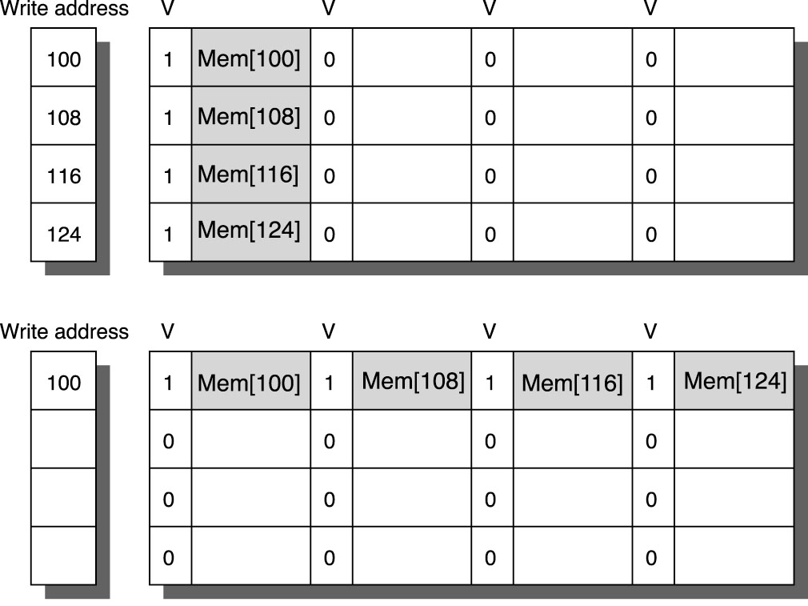
Example
Below we see 4 consecutive writes being placed in separate rows of the buffer (top)
instead, since all four writes are to the same write, we place them in the same row
1 write instead of 4
Assume the 4 writes occur
inside a loop, each write being
4 instructions later than the
previous and 25 clock cycle
memory access time
Sending each item to memory
will cause delays in accessing
the write buffer of 21 cycles each
(84 total cycles) but if written to
a single line, only 21 cycles total

Slide 37
Compiler Optimizations
Compiler scheduling can improve cache accesses by grouping together accesses of items in the same cache block
loop interchange: exchange loops in a nested loop situation so that array elements are accessed based on order that they will appear in the cache and not programmer-prescribed order
for(j=0;j<100;j++)
for(i=0;i<5000;i++)
x[i][j] = 2*x[i][j];
currently, the for loops cause array elements to be accessed in column-major order but they are stored in memory (and cache) in row-major order: exchange the two loops

Slide 38
Continued
Imagine a line stores 16 words
An image processing routine processes a matrix element (image[i][j]) and its neighbors
image[i-1][j-1], image[i-1][j], image[i-1][j+1], image[i][j-1], image[i][j+1], image[i+1][j-1], image[i+1][j], image[i+1][j+1]
knowing this, rather than operating on [i][j] in a row-by-row manner, with blocking, the compiler rearranges the loops so that once the neighbors are loaded into cache, all of the neighbors are processed first
in this way, items loaded to process [i][j] and then discarded some time later (e.g., [i+1][j]) do not need to be reloaded later
see the example on pages 108-109

Slide 39
Hardware Prefetching
Prefetching can be controlled by hardware or compiler (see the next slide)
prefetching can operate on either instructions or data or both
one simple idea for instruction prefetching is that when there is an instruction miss to block i, fetch it and then fetch block i + 1
this might be controlled by hardware outside of the cache
the second block is left in the instruction stream buffer and not moved into the cache
if an instruction is part of the instruction stream buffer, then the cache access is cancelled (and thus a potential miss is cancelled)
if prefetching is to place multiple blocks into the cache, then the cache must be non-blocking
see figure 2.15 on page 110 to see the speedup of many SPEC 2000 benchmarks (mostly FP) with hardware prefetching (speedup ranges from 1.16 to 1.97)

Slide 40
Compiler Pre-fetching
The compiler inserts prefetching instructions into the code (for data prefetching only)
the code below on the left causes 150 misses array from a and 101 from b
assume an 8KB direct-mapped cache with 16 byte blocks, and a and b are double arrays
code with prefetch compiler instructions has only 19 misses
see pages 112-113 for an analysis of the misses
for (j=0;j<100;j=j+1) {
prefetch(b[j+7][0]); /* prefetch 7 */
prefetch(a[0][j+7]); /* later */
a[0][j]=b[j][0]*b[j+1][0];};
for (i=1;i<3;i=i+1)
for (j=0;j<100;j=j+1) {
prefetch(a[i][j+7]);
a[i][j]=b[j][0]*b[j+1][0]; }
for (i=0;i<3;i=i+1)
for (j=0;j<100;j=j+1)
a[i][j]=b[j][0]*b[j+1][0];

Slide 41
Victim Cache
In a direct-mapped cache, consider the following assuming a cache of 512 entries where block x is not yet in the cache:
access block x (cache miss)
access block x + 512 (cache miss, block x discarded)
access block x (cache miss)
3 misses in 3 accesses
A victim cache is a small, fully associative cache, consulted on an L1 cache miss
might store 1-5 blocks
Victim cache only stores blocks that have been discarded from the cache on a cache miss
on a cache miss, examine victim cache and request from next level
on victim cache hit, cancel request to next level, exchange item in victim cache and item in same line in direct-mapped cache

Slide 42
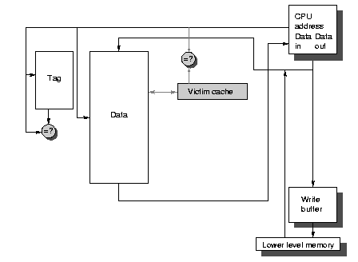
Continued
Hit time =1
Miss rate decreases slightly because we have a little associativity here
Miss penalty:
if item is in victim cache, miss penalty is a little more than 2 (not exactly 2 because the victim cache is associative)
if not in victim cache, miss penalty remains the same because (we had already started the request to the next level)
on a hit in victim cache, swap items between L1 and victim cache so L1 cache either must be non-blocking or causes a 1-2 cycle stall (depending on how many cycles the exchange takes)
Note: we are skipping HBM
(high bandwidth memory)
L4 caches, see p. 114-117)

Slide 43
Summary
Note: power consumption omitted
Technique | Miss Penalty | Band-width | Miss Rate | Hit Time | Hardware Complexity | Comments: (* means widely used)
Larger block sizes | - |  | + |  | 0 | Trivial
Larger caches |  |  | + | - | 1 | * especially L2 caches
Higher associativity |  |  | + | - | 1 | *
Multilevel caches | + |  |  |  | 2 | *, costly, difficult if L1 block size != L2 block size
Read miss over write priority | + |  |  |  | 1 | *
No address translation |  |  |  | + | 1 | *
Small/simple caches |  |  | - | + | 0 | *, trivial
Way prediction |  |  |  | + | 1 | Pentium IV
Pseudo associative cache |  |  | + |  | 2 | Found in RISC

Slide 44
Continued
Technique | Miss Penalty | Bandwidth | Miss Rate | Hit Time | Hardware Complexity | Comments: (* = widely used)
Trace cache |  |  |  | + | 3 | Pentium IV
Pipelined accesses |  | + |  | - | 1 | *
Nonblocking caches | + | + |  |  | 3 | Used with all OOC
Multibanked caches |  | + |  |  | 1 | For L2 caches
Early restart | + |  |  |  | 2 | *
Merging write buffer | + |  |  |  | 1 | * for write-through caches
Compiler techniques |  |  | + |  | 0 | Software is challenging
Hardware prefetching | + |  | + |  | 2 (instr) or 3 (data) | * for instr, P4 & Opteron for data
Compiler prefetching | + |  | + |  | 3 | *, needs non-blocking cache
Victim caches | + |  |  | + | 2 | AMD Athlon
HBM as L4 cache | - | +/- |  | + | 3 | varies

Slide 45
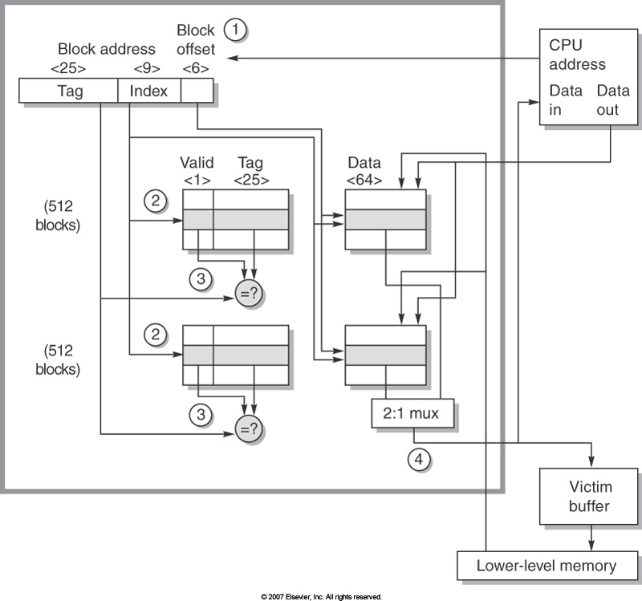
Opteron Data Cache
2 way set associative cache
512 lines per set
64 KBytes
64 bytes per line
CPU address: 40 bits
25 bit tag
9 bit block number
6 bit byte number
Write back cache, valid bit (dirty bit) needed
LRU replacement strategy
Victim
buffer
discussed
later
Tag comparisons MUX to select one
block on a tag match

Slide 46
VM: Review
Backing up DRAM with swap space on hard disk
requires page → frame number translation
use TLB (L1 cache) and page table (DRAM)
Concerns
address translation doubles (at least) access time because of two cache accesses
store items in L1 (and maybe L2/L3) cache by virtual address rather than physical address (complex, may or may not be desirable)
multitasking requires additional mechanisms to ensure no memory violation
especially if pages are shared between processes/threads
if a single page table for all processes then page table must encode who can access the given page
textbook spends several subsections on VMs, we are skipping this

Slide 47
Comparing Cache and VM
Parameter | First-level cache | VM
Block/page size | 16-128 bytes | 4K-64KB
Hit time | 1-3 clock cycles | 100-200 clock cycles
Miss penalty | 8-200 clock cycles | 1,000,000+ clock cycles
access time | 6-160 clock cycles | 800,000+ clock cycles
transfer time | 2-40 clock cycles | 200,000+ clock cycles
Miss rate | .1%-10% | .00001%-.001%
Address mapping | 25-45 bit physical address to 14-20-bit cache address | 32-64-bit virtual address to 25-45-bit physical address
Miss rates for DRAM need to be very small or else the miss penalty
has far to great an impact on performance

Slide 48
Fast Address Translation
Recall we want to avoid address translation
instruction and data caches usually store items by virtual addresses rather than physical addresses which brings about two problems
must ensure proper protection that the virtual address is legal for this process
on a cache miss, we still need to perform address translation
Address translation uses the page table
resides in memory
very large page tables could, at least partially, be stored in swap space
use a TLB (on-chip cache) to cache paging information to reduce impact of page table access, but TLB is usually an associative cache
virtual address is the tag
frame number is the datum
TLB entry also contains a protection bit (is this page owned by this process?) and a dirty bit (is the page dirty, not is the TLB entry dirty?)
using associative cache slows the translation process down even more (beyond a second cache access) but there’s not much we can do about it!

Slide 49
Selecting a Page Size
Larger page sizes
smaller page table size (fewer overall pages for a process)
transferring more data at a time is a more effective use of accessing a hard disk
fewer pages also means more entries in the TLB (proportionally)
Smaller page sizes
less potential wasted space (smaller fragments)
less time to load a page from disk (smaller miss penalty – while this is smaller, it means a less effective disk access)
Some CPUs today support multiple page sizes based on the program size
we prefer small pages if the program is smaller

Slide 50
Implementing a Memory Hierarchy
Autonomous instruction fetch units
with out-of-order execution, we remove the IF stage from the pipeline and move it to a separate IF unit
IF unit accesses instruction cache to fetch an entire block at a time
move fetched instructions into a buffer (to be decoded one at a time, and flushed if a branch had been taken)
miss rates become harder to compute because multiple instructions are being fetched at a time on any hit, some of them may be misses
similarly, prefetching data may result in partial misses

Slide 51
Continued
Speculation
causes a previously fetched instruction to be executed before the hardware has computed whether a branch should have been taken or not
Need memory support for speculation
proper protection must be implemented
a memory violation arising when a fetched instruction should not have been fetched due to miss-speculation should not cause an exception
to maintain a precise, memory violation must be postponed
details on protection can be found in appendix B pages B-49 – B-54)
cache miss after miss-speculation throws off the miss rate
because the instruction should never have been fetched

Slide 52
Cache Coherence
With multi-core processors (or any parallel processor), we now have a new concern
core 1 has loaded datum x from memory into its L1 cache, which is a write-back cache
core 1 increments x in its cache, but not yet to memory
core 2 now loads datum x from memory into its L1 cache
core 2 has a stale (dirty) version of x
this cannot be allowed
we resolve this by implementing cache coherence
we look at this in chapter 5

Slide 53
ARM Cortex-A53 Mem Hierarchy
Issue up to 2 instructions per cycle
three TLBs: instruction TLB, data TLB, second level TLB (L2 version of a TLB)
instruction and data TLBs are 2-way set associative and can store up to 10 entries each – 2 cycle penalty on a TLB miss
second level TLB is 4-way set associative with 512 entries and a 20 cycle miss penalty (to get to page table in memory)
TLBs use critical word first with early restart
L1 instruction and data caches: 2-way set associative, 64-byte block, 13 cycle miss penalty
L2 unified cache: 16-way set associative, LRU, 124 cycle miss penalty
see figure 2.20 on page 131 if you want to be confused!

Slide 54
Memory Performance
Tested on SPECInt2006 benchmarks
32KB L1 caches, 1MB L2
miss rate for L1 was mostly under 5%
reached 10% on two and 35%+ on mcf
miss rate for L2 was under 1% for most
miss penalty was under 1 cycle for most benchmarks
2-5 for 3 others, 16 for mcf

Slide 55
Intel Core i7 6700 Mem Hierarchy
Out of order execution processor, four cores
We focus on the memory hierarchy of a single core
each core can issue up to 4 instructions at a time
16-stage pipeline, dynamically scheduled
up to 3 memory banks can be accessed simultaneously
48-bit virtual memory → 36-bit physical memory
3-level cache hierarchy (but can support a fourth level using high-bandwidth memory)
L1 indexed by virtual address, L2 & L3 use phys addr
this led to an oddity in that the L2 could cache an instruction both by virtual address (when backing up L1) and physical address
TLB access and L1 caches accessed simultaneously to reduce impact of a cache miss requiring address translation
two TLBs (instruction, data) are 8-way associative

Slide 56
More
Here are a few more details
L1 instruction cache is divided into 8 banks for simultaneous accesses
L2 cache uses write-back with a 10-entry merging write buffer
hardware prefetching performed on both L1 and l2
usually just the next block after the one being requested
Performance is hard to determine
OOC nature of the processor
separate instruction-fetch unit (which attempts to fetch 16 bytes at a time)
L1 miss rate using prefetching ranged between 1% and 22% for SPEC2006Int benchmarks, mostly 1-3%
instruction fetch unit is stalled less than 2% of the time for most programs, up to 12% for one

Slide 58
Fallacies and Pitfalls
P: predicting cache performance from one program to another
cache performance can vary dramatically because of the nature of a program’s branches, use of arrays, local variables, pointers, etc
P: not delivering high memory bandwidth to the cache
moving too little at a time causes cache performance to degrade
P: having too small an address space
not providing enough bits for either a physical or virtual address (this limitation can arise because of the size of address registers and the address bus)

